Slide 1
Flight Delay Predictor
Maneesha Tejani, Sahan Reddy

Slide 2

Introduction
We are working on the problem of flight delays caused by different conditions such as Weather, Airline delays and many other factors. Through this project, we aim to predict the expected delay for any given airline.

Slide 3
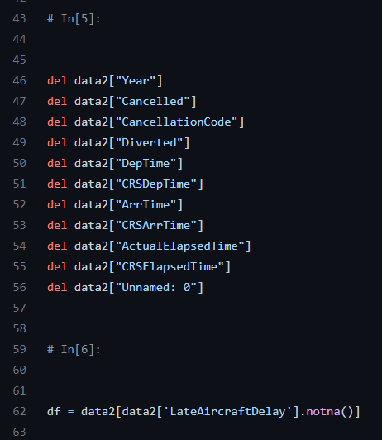
Dataset
We decided to use the Open Source Flight Dataset that is provided by Kaggle to develop our model. (https://www.kaggle.com/datasets/giovamata/airlinedelaycauses)
Preprocessing
This dataset has a total of 30 columns. There are a lot of columns in this database which are redundant in predicting flight delays. Those columns were discarded.
Some columns were also used in deriving values in other columns. (E.g. DepTime, CRSDepTime used to calculate another field – DepDelay).

Slide 4
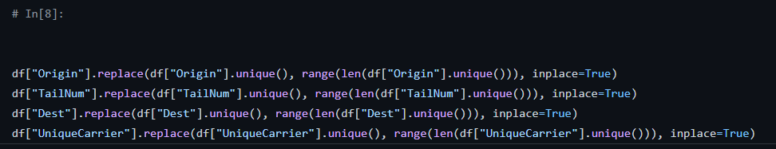
We had also decided on a linear regression algorithm to train our ML model. So we had to change some of our numeric columns to include categorical values.
Thus, we were able to eliminate around 10 redundant columns remove incomplete rows from our dataset.

Slide 5
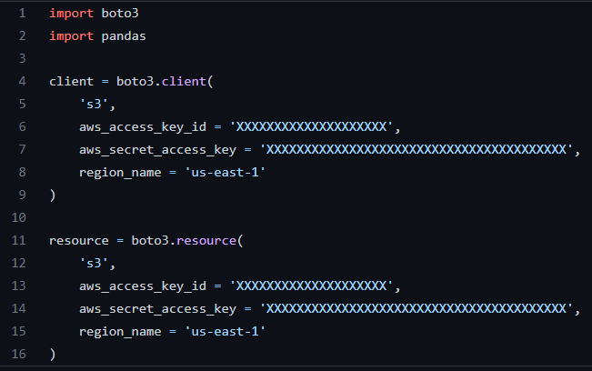
AWS S3
We used Amazon’s S3 bucket for cloud storage. We retrieve our dataset from the S3 bucket and then work on preprocessing the retrieved data.
We have enabled bucket versioning on S3 which enables us to recover from unintended user actions and application failures.
Data stored on the bucket is also set to be automatically encrypted by the default encryption by the AWS KMS keys.
S3 object locks have also been enabled which help to prevent deletion or modification of data for a set period of time adding extra protection against accidental deletion of objects on the bucket.

Slide 6
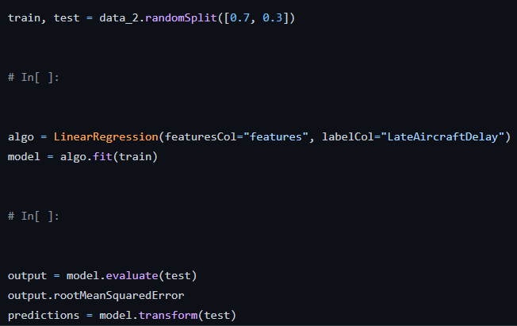

Spark ML
We decided to go with a Linear Regression algorithm from Spark ML to train our model.
Train/Test Split: 70/30
Root Mean Squared Error was used to gauge the accuracy of our trained model.

Slide 7
